Slide 1
RADP 20-21 CIVIL WORKS
DPP_Item | Kishorgonj | Hobogonj | Netrokona | Sunamgonj | Total
Construction of Irrigation Inlet (New Haors) | 354.62 | 128.76 | 36.54 | 142.04 | 661.96
Re-installation/Construction of Regulator/Causeway (Rehabilitation Sub-Projects) | 44.79 | 0 | 79.2 | 0 | 123.99
Installation/Construction of New Regulators/Causeway/Bridge/Box Drainage Outlet) (New Haors) | 2460.16 | 1788.03 | 1242.58 | 1338.55 | 6829.32
Re-excavation of Khal/River (New Haors) (Earth Volume: 68.97 Lakh cum) | 1210.55 | 110.64 | 273.4 | 545.27 | 2139.86
Re-excavation of Khal/River (Rehabilitation Sub-Projects) (Earth Volume: 28.01 Lakh cum) | 400.66 | 148.55 | 898.45 | 0 | 1447.66
Rehabilitation of Full Embankment (Resection/construction) (Rehabilitation Sub-Projects) (Earth Volume: 9.16 lakh cum) | 0 | 0 | 356.96 | 0 | 356.96
Rehabilitation of Submergible Embankment (Resection/construction) (Rehabilitation Sub-Projects) (Earth Volume: 7.43 lakh cum) | 0 | 117.93 | 482.08 | 0 | 600.01
Construction of Submersible Embankment (New Haors) (Earth Volume: 25.68 lakh cum) | 1498.18 | 490.86 | 0 | 314.54 | 2303.58
Rehabilitation of Regulator (New Haors) | 120.56 | 0 | 6.95 | 0 | 127.51
Thershing Floor Construction | 0 | 0 | 0 | 0 | 0
Construction of WMG Office | 0 | 0 | 0 | 0 | 0
Gate_Repair | 0 | 0 | 0 | 0 | 0
Total | 6089.52 | 2784.77 | 3376.16 | 2340.4 | 14590.85

Slide 2
ITEM WISE DISTRIBUTION OF RADP 20-21 in BDT CRORE FOR WHOLE PROJECT

Slide 3
ITEM WISE DISTRIBUTION OF RADP 20-21 in BDT CRORE FOR KISHOREGONJ

Slide 4
ITEM WISE DISTRIBUTION OF RADP 20-21 in BDT CRORE FOR HOBIGANJ

Slide 5
ITEM WISE DISTRIBUTION OF RADP 20-21 in BDT CRORE FOR NETROKONA

Slide 6
ITEM WISE DISTRIBUTION OF RADP 20-21 in BDT CRORE FOR SUNAMGONJ

Slide 7
IMMEDIATE ACTIONS REQUIRED FOR KISHOREGONJ
Package | STC | Name | Unit | Quantity | Contract value
KISH/PW-01 | 8 | katakhali khal from KM 0.000 to KM 1.550=1.550 KM | Km | 1.55 | 19.18
KISH/PW-01 | 8 | Ganakkhali Khal from KM 0.000 to KM 5.625=5.625 KM | Km | 5.625 | 309.8
KISH/PW-01 | 8 | kali Khal from KM 0.00 to KM 1.000=1.000 KM | Km | 1 | 45.95
KISH/PW-01 | 2 | Repair & Maintenense Alalia Bahadia Regulator 2 vent | Km | 1 | 44.79
Total KISH/PW-01 |  |  |  |  | 419.72

Slide 8
IMMEDIATE ACTIONS REQUIRED FOR KISHOREGONJ
Package | STC | Name | Unit | Quantity | Contract value
KISH/PW-18 | 7 | Re-Excavation of PangairDairKhal from KM 0.080 to KM 4.360 = 4.280 KM | Km | 4.28 | 101.20
KISH/PW-18 | 7 | NandirKhal from KM 0.00 to KM 5.985=5.985 KM | Km | 5.985 | 141.52
KISH/PW-18 | 7 | KhaiyerKhal from KM 0.495 to KM 8.405=7.910 KM | Km | 7.91 | 187.03
KISH/PW-18 | 5 | Causeway 4m wide-1 DheuhalKhal at km 12.44 | Nos | 1 | 159.86
Total KISH/PW-18 |  |  |  |  | 589.61
KISH/PW-21 | 12 | Rehabilitation of 5nos Regulator (2 vent 1.50m x 1.80m- 2nos, 1 vent 1.50m x 1.80m- 3nos) | Nos | 5 | 120.56
KISH/PW-21 | 11 | Sub-Mergible Embankment From km. 2.565 to km 12.059 = 9.494 km | Km | 9.494 | 329.11
Total KISH/PW-21 |  |  |  |  | 449.57

Slide 9
IMMEDIATE ACTIONS REQUIRED FOR KISHOREGONJ
Package | STC | Name | Unit | Quantity | Contract value
KISH/PW-25 | 5 | Joyshiddhi Causeway 6.0m wide-1 | Nos | 1 | 346.41
KISH/PW-25 | 5 | Shankir Khal Causeway 6.0m wide-2 | Nos | 1 | 288.08
KISH/PW-25 | 4 | Box Sluice-1 | Nos | 1 | 41.82
Total KISH/PW-25 |  |  |  |  | 676.32
KISH/PW-26 | 11 | Construction of sub-mergible embankment in between km 8.200 to km 18.030 = 0.540 km | Km | 0.54 | 22.72
KISH/PW-26 | 7 | Re-excavation of Khal Phulesswari khal from km 0.000 to km 3.960 = 3.960 km | Km | 3.96 | 71.53
KISH/PW-26 | 7 | Goalkhali Khal from km 0.500 to km 2.600 = 2.100 km | Km | 2.1 | 12.72
KISH/PW-26 | 7 | Kalna Khal from km 0.800 to km 1.940 = 1.140 km | Km | 1.14 | 16.39
KISH/PW-26 | 7 | Suti Nadi from km 2.200 to km 17.700= 15.500 km) | Km | 15.5 | 367.32
Total KISH/PW-26 |  |  |  |  | 490.67

Slide 10
IMMEDIATE ACTIONS REQUIRED FOR KISHOREGONJ
Package | STC | Name | Unit | Quantity | Contract value
KISH/PW-27 | 5 | Chonati Causeway | Nos | 1 | 140.87
KISH/PW-27 | 5 | 6.60m Suti Causeway & Drainage | Nos | 1 | 407.31
KISH/PW-27 | 4 | Rahela Phuleswari RCC Box Drainage Outlet | Nos | 1 | 41.88
KISH/PW-27 | 3 | Phuleshwari Khal Regulator | Nos | 1 | 156.62
KISH/PW-27 | 3 | Kalna 1-V regulator | Nos | 1 | 148.00
Total KISH/PW-27 |  |  |  |  | 894.68

Slide 11
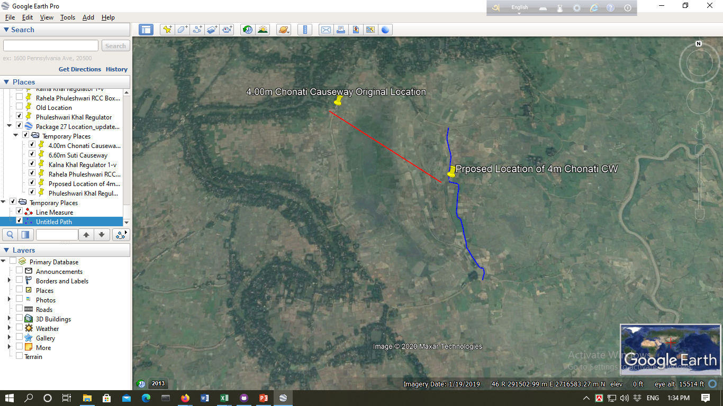
JICA’S APPRECIATION
1.5 Kilometers
Additional Embankment
1.85 Kilometers

Slide 12
IMMEDIATE ACTIONS REQUIRED FOR HOBIGANJ
Package | STC | Name | Unit | Quantity | Contract value
HOBI/PW-01 | 3 | Construction of 6.00 m Wide Causeway-1 no. | nos. | 1 | 247.53
HOBI/PW-02 | 8 | Reexcavation of Kairdhala Khal from 0.000 to 1.6950 km | Km | 1.695 | 132.87
HOBI/PW-05 | 3 | Boranbil khal Regulator (1-vent) | nos. | 1 | 141.32
HOBI/PW-05 | 3 | Chandakhali khal Regulator(1-vent) | nos. | 1 | 154.07
HOBI/PW-05 | 3 | Tetter Drepasionkhal Regulator(2-vent) | nos. | 1 | 216.75
Total Hobigonj |  |  |  |  | 892.54

Slide 13

JICA’S APPRECIATION

Slide 14
WHY DID WE GET APPRECIATION
For Accurate Representation of Flood Situation in the project area(Damage)
For Representation and Explaining in detail of Design of different type of protection work.
For Presentation of Activity plan for civil works next two dry seasons
Progress in agriculture component and plan for next FY
Presentations of civil works monitoring format

Slide 15
Commitment Made to JICA
Commitments to JICA | Follow ups
1. Inclusion of Type B1 protective work for 200m pilot basis | Consultant had been notified to find suitable reach
2. Quality Monitoring Civil Work Plan | 1. QA format finalized 2. Specification drafted (Needs immediate finalization)
3. Improvement of Embankment Turfing | 1. No standard test could be identified 2. Only visual inspection.

Slide 16
Commitmenta Made to JICA
Photos of condition after major construction activities shall be taken at a regular intervals, e.g. every 200 m, and added to the report.
In case of Type A:
Before the construction of protection work
Before applying 100mm thick sand layer
After applying 100mm thick sand layer
After applying Geotextile Filter Cloth
After applying 100 m thick assorted filter
After applying CC blocks

Slide 17
Commitmenta Made to JICA

Slide 18
Commitmenta Made to JICA
Shaping of embankment crest and slope in design level and in desired compaction.
Selection of turfing source.
Cutting and transporting turf in 250mmx250mmx75mm size.
Planting turf in embankment slope without any gap in staggered formation within February .
Continuous watering upto defects liability period.
Application of fertilizer in proportion N:P:K=16:5:12
Replanting if needed in any defect area.

Slide 19
Work Program for 2020-21

Slide 20
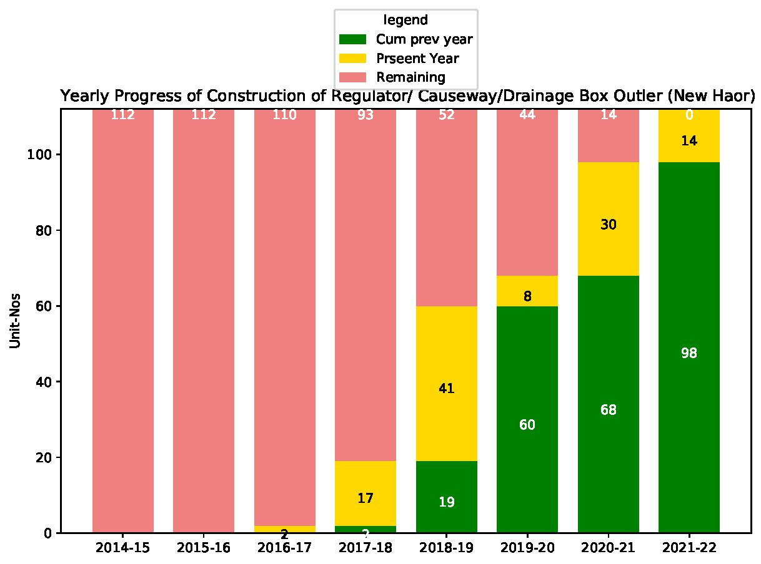
Activity Plan for Next TWO Years?

Slide 21
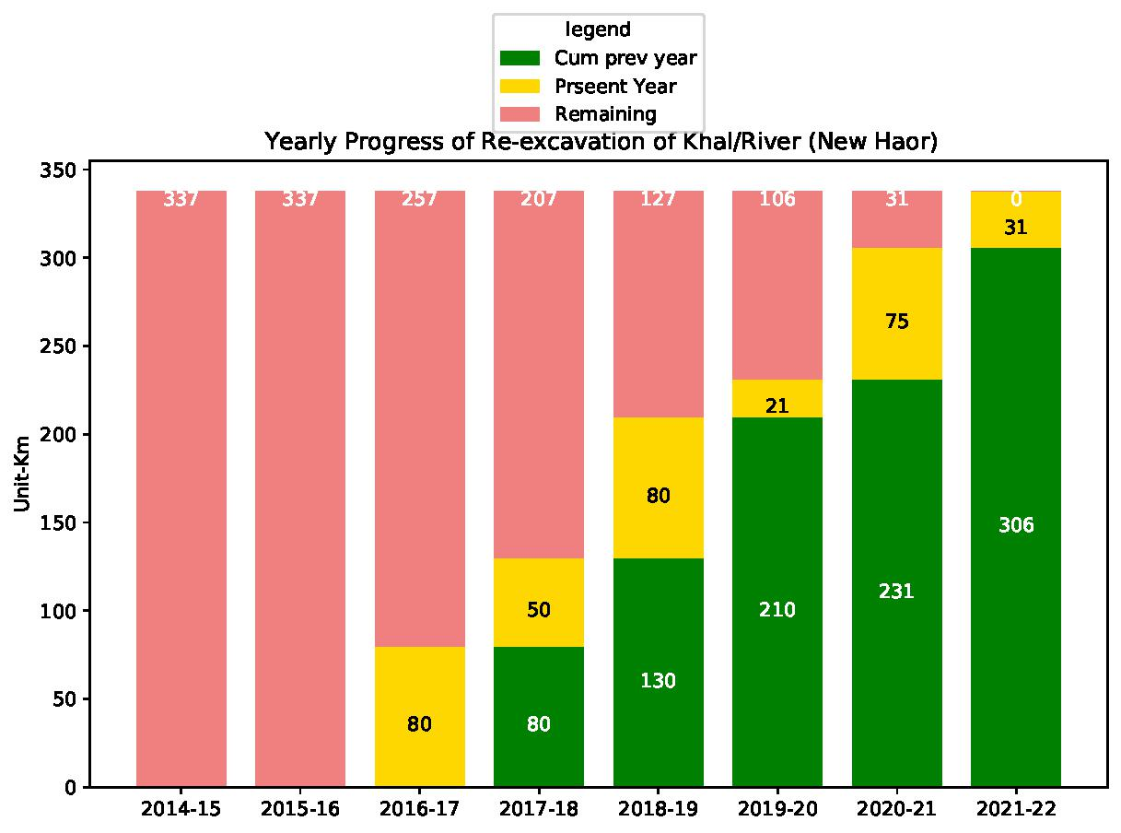
Progress of Re-excavation of Khal/River (New Haor)

Slide 22
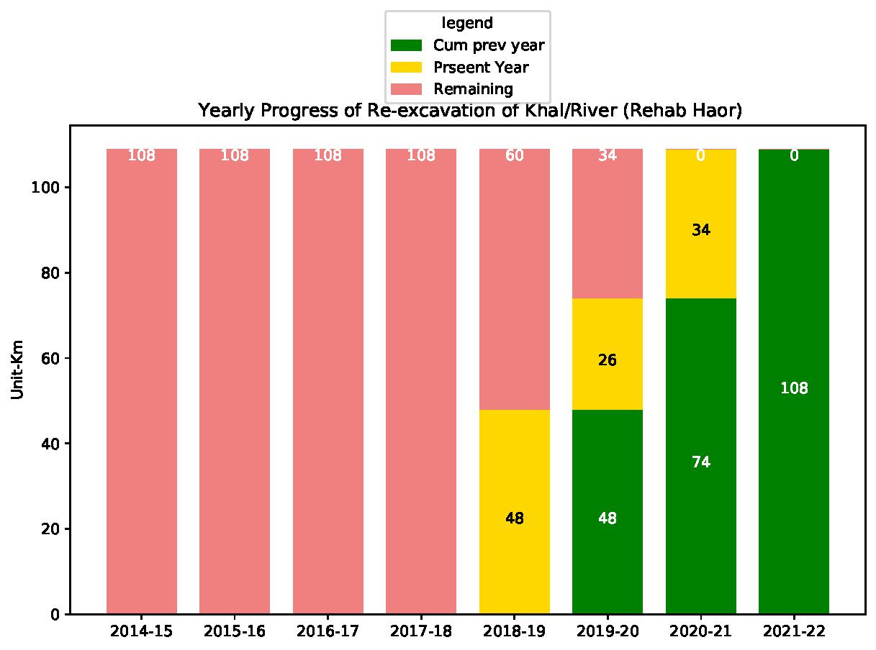
Progress of Re-excavation of Khal/River (Rehab Haor)

Slide 23
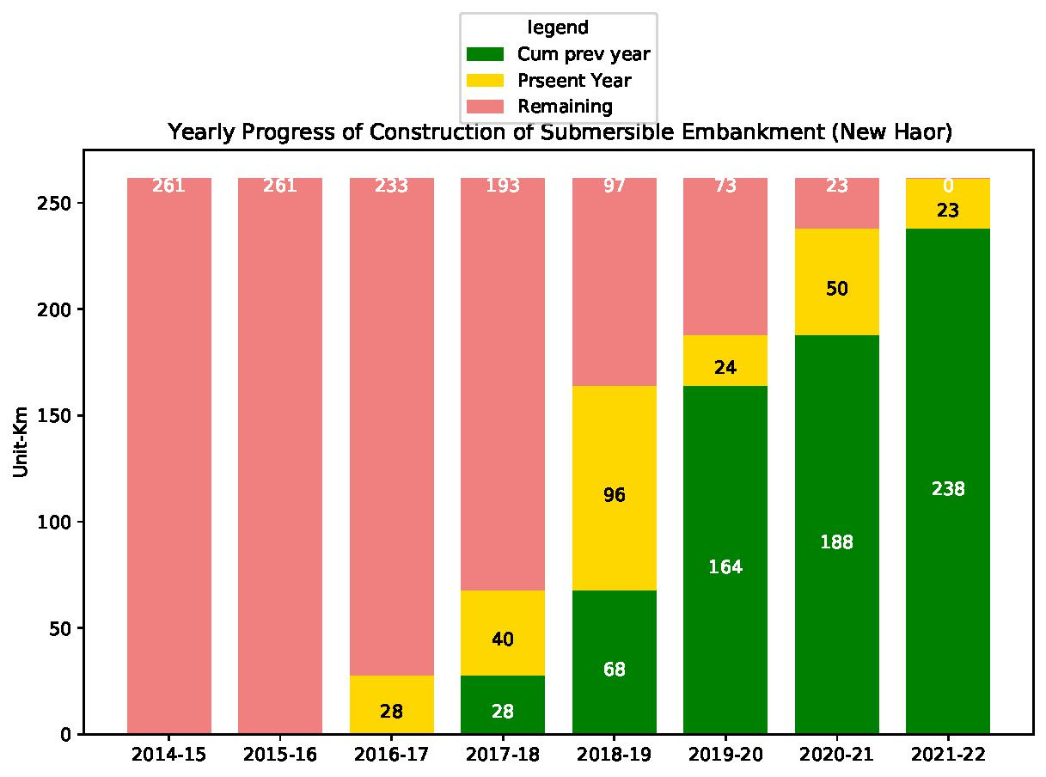
Progress of Construction of Submersible Embankment (New Haor)

Slide 24
Year wise Civil Works Expenditure

Slide 25
Specification What Does It Contain?
How ,when and by whom measurement for Individual work Item will be given.
1.How ,when ,by whom and in what frequency Quality Assurance Tests for Individual work items will be performed.
Schedule of Tests for different work Items.

Slide 26
Measurement
All the measurement will be carried through Joint Measurement Team (JMT)
Constituting Members | Designation
Concerned Sub-Divisional Engineer | Convener
Concerned SAE/SO. | Member
Concerned Field Inspector. | Member
Representative of the Contractor | Member
Concerned Field Supervision Engineer. | Member Secretary

Slide 27
Measurement
Work Scope of JMT
Submit Measurement Every 15days in standard format. (Annex-II: Standard Forms for Measurement)
Ensure Quality Control tests performed properly
Submit monthly quality control report for every site/reach/structure..
After Completion prepare a defect liability schedule

Slide 28
Measurement Format for CC Block

Slide 29
Measurement Format for RCC Work

Slide 30
Measurement Format for Reinforcement

Slide 31
Measurement Format for Earth Work

Slide 32
Measurement Format for Earth Work

Slide 33
Measurement Format for General Items Not Covered Above

Slide 34
Summary of Measurement

Slide 35
Standard Sampling and Testing for Embankment
Sl | Name of Test | Frequency of Test | Test Method
1 | Atterberg's Limit (Plastic Limit & Liquid Limit) | 1. For each source of fill materials 2. One Sample for each 10,000 Cum of fill material 3. Change in the Characteristics of the material noticed on visual examination. | ASTM D 4318 or Equivalent
2 | Grain Size Distribution | As stated above | ASTM D 422 or Equivalent
3 | Modified Proctor Test | As stated above | ASTM D 1557 & ASSTO T 180 D
4 | Moisture Content | I .For each 5000 cum of fill material 2. As per direction of the Project Manager. | ASTM D 4346 & ASTM D 4944 or V Equivalent
5 | Field Dry Density Test | 1. One Sample for each 1000 sqm of compacted surface in each layer 2. As per direction of the Project Manager. | AAHSTO T191 or Equivalent

Slide 36
Standard Sampling and Testing for CC Block
Sl | Name of Test | Frequency of Test | Test Method
1 | Cement: Fineness Soundness Initial Setting Time and Final Setting Time Compressive Strength Tensile Strength Unit Weight | For each fresh Consignment arriving at Site For each 100 M. Ton As approved or directed by the Project Manager. | ASTM C786, ASTI C403, ISO 679:2009 or Equivalent
2 | Fine Aggregate (Sand) i) Fineness Modulus | 1(one) Sample for each 350 Cum or part thereof At least 1 Sample in a week As approved or directed by the Project Manager. | ASTM C 33 or Equivalent
3 | Coarse Aggregate (Stone Chips) Gradation Test | 1(one) Sample for each 700 Cum or part thereof At least 1 Sample in a week As approved or directed by the Project Manager. | ASTM C330, AASHTO T-85, BS- 812, ASTM C-535 or Equivalent
4 | Water Suitability of Water for Concrete Mixing | For Each source of Water As approved or directed by the Project Manager. | BS EN BS EN 1008:2002
5 | Concrete Concrete Core Test | Concrete Core Test will be carried out for at least one block for each days casting As approved or directed by the Project Manager. | BS 1881, ASTM C-42 Or similar standard

Slide 37
Standard Sampling and Testing for Geo Textile
Si | Name of Test | Frequency of Test | Test Method
1 | Geotextile Filter Materials:
 | i. Opening Size 0₉₀ | 1.for each quantity of 10,000 square meter 2.At Least 1 test for Total Requirements in Reach of Work if that is less than 10000 square meter | EN ISO 12956
 | Mass per unit area | 1.for each quantity of 10,000 square meter 2.At Least 1 test for Total Requirements in Reach of Work if that is less than 10000 square meter | BS EN 965
 | CBR Puncture Resistance | 1.for each quantity of 10,000 square meter 2.At Least 1 test for Total Requirements in Reach of Work if that is less than 10000 square meter | EN ISO 12336
 | Tensile Strength (machine direction- MD or cross machine direction-CMD) | 1.for each quantity of 10,000 square meter 2.At Least 1 test for Total Requirements in Reach of Work if that is less than 10000 square meter | EN ISO 10319
 | Minimum thickness | 1.for each quantity of 10,000 square meter 2.At Least 1 test for Total Requirements in Reach of Work if that is less than 10000 square meter | EN ISO 9863
 | Grab Tensile Strength | 1.for each quantity of 10,000 square meter 2.At Least 1 test for Total Requirements in Reach of Work if that is less than 10000 square meter | ASTM D 4632
 | Vertical Permeability under 2Kn/m² & 200Kn/m² pressure | 1.for each quantity of 10,000 square meter 2.At Least 1 test for Total Requirements in Reach of Work if that is less than 10000 square meter | ASTM D4491
 | viii. Horizontal Permeability under 2Kn/m² pressure | 1.for each quantity of 10,000 square meter 2.At Least 1 test for Total Requirements in Reach of Work if that is less than 10000 square meter | ASTM D4491

